Slide 1
Lecture 9
Closing the Gross Financing Gap
Open Learn Collection
Financial Modelling for Energy Transitions: MINFin, FinTrack & FinCoRE

Slide 2
Lecture Outline
Financial Modelling for Energy Transitions
 | Learning Objectives
Part 1 | Different Approaches to Closing the Gap
Part 2 | Reducing Financing Requirement
Part 3 | Boosting Funding Availability
Part 4 | Choosing and Combining Approaches

Slide 3
Learning Outcomes
Understand the concept of a financing gap.
Identify the two different approaches for closing a financing gap and the various measures that can be taken under each.
Design a strategy for closing a financing gap by choosing and combining different measures.

Slide 4
Different Approaches to Closing the Gap
Part 1

Slide 5

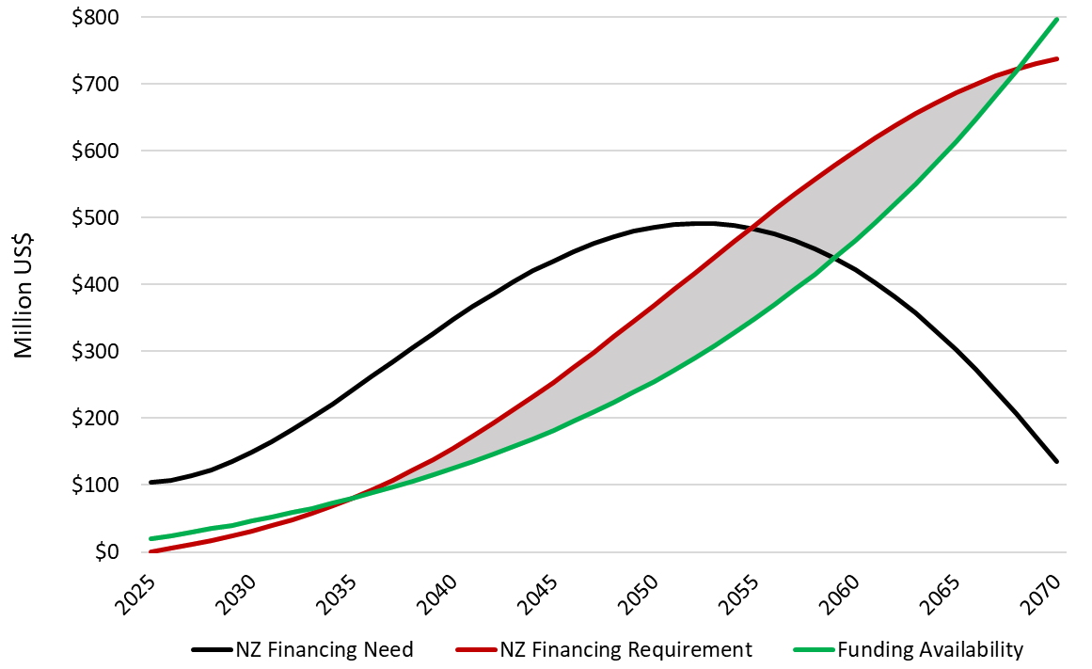
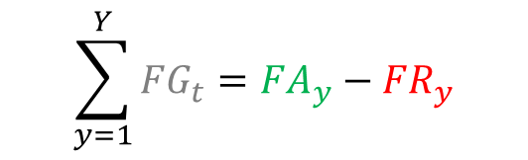
Definition of a Financing Gap
A Financing Gap (FG) occurs any year when the Financing Requirement (FR) for the energy transition exceeds the Funding Availability (FA).
The figure demonstrates that a Financing Gap (FG) occurs any year that the red line lies above the green line
Financing Gap
$$\sum_{y=1}^{Y}{{FG}_{t}}={FA}_{y}−{FR}_{y}$$
Notes:
A Financing Gap (FG) occurs any year when the Financing Requirement (FR) for the energy transition investment plan exceeds the Funding Availability (FA).
In addition to saying this in words, it can also be expressed in mathematical terms and in pictures.
The mathematical expression clarifies that the Financing Gap (FG) is defined on an annual basis, and that these annual gaps can be added-up over time to give to cumulative total gap over the period of interest. In principle, negative financing gaps (which might better be described as funding surpluses) also exist in years when Funding Availability (FA) exceeds the Financing Requirement (FR). In practice, it may or may not be possible to net these out over time.
In graphical terms, a Financing Gap (FC) exists in any year when the red line representing the Financing Requirement (FR) lies above the green line representing Funding Availability (FA). The vertical distance between the two lines represents the size of the financing gap, while the area between the two lines represents the cumulative size of the financing gap over time.
It is important to note that this lecture focuses on the gross financing gap, which is defined relative to the overall Net Zero transition investment plan. A separate discussion on the net financing gap will take place in the next lecture.

Slide 6

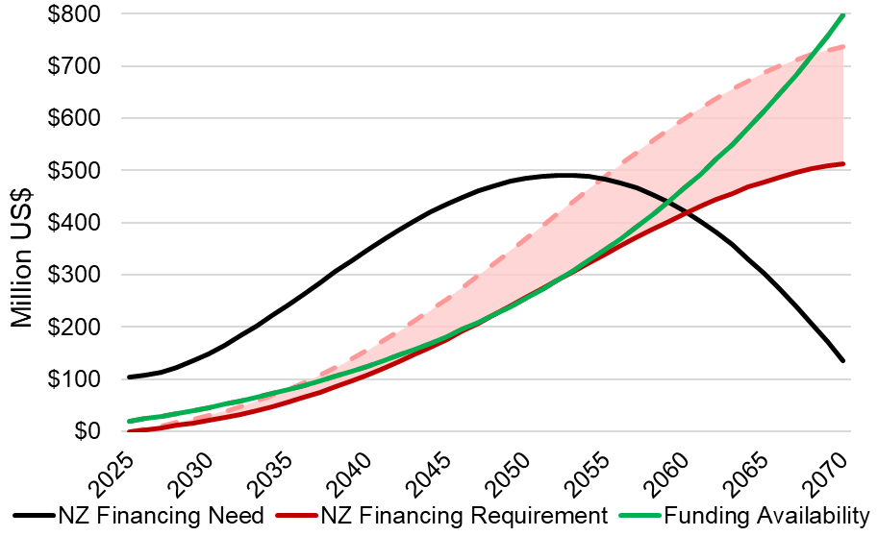
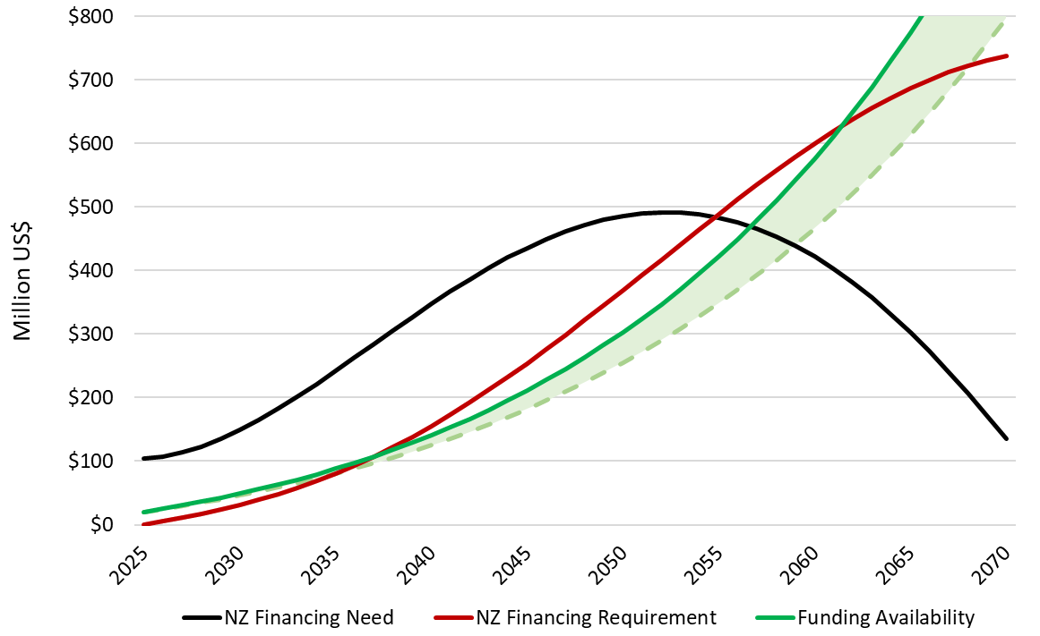
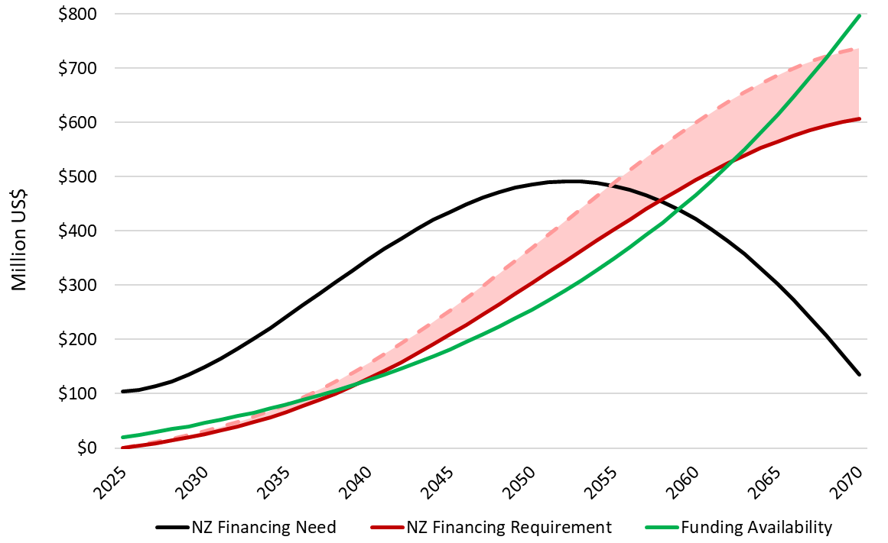
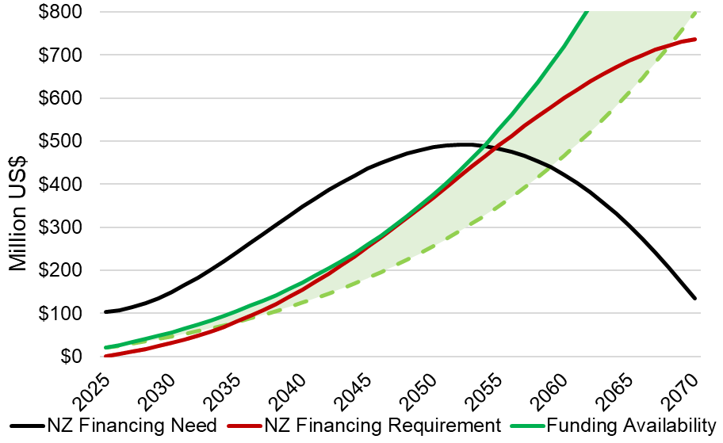
Two Different Ways of Closing Financing Gaps
There are only two ways to close a financing gap
EITHER the Financing Requirement (FR) needs to be reduced
AND/OR the Funding Availability (FA) needs to be increased
Notes:
It follows that there are just two ways of closing the Financing Gap (FG):
Either, there must be a reduction in the Financing Requirement (FR) (shifting the red line downwards as in the left-hand chart),
Or, there must be an increase in Funding Availability (FA) (lifting the green line upwards in the right-hand chart).
In practice, there are numerous practical measure that can be taken to achieve either of these outcomes. These measures will be introduced in greater detail in the remaining sections of the lecture.
Please note that the current framework does not allow for a perfect alignment of the Financing Requirement (FR) (red line) and Funding Availability (FA) (green line) over time. Instead, we will focus simply on ensuring that the Funding Availability (FA) is at least as high as the Financing Requirement (FR) in every time period, leaving the possibility that funding surpluses might exist in specific time periods.

Slide 7
Reducing financing requirement
Part 2

Slide 8
Ways to reduce the Financing Requirement
There are several ways to reduce the Financing Requirement
Reduce the WACC for Commercial Finance
Increase the share of Concessional Finance
Adopt a lower cost Investment Plan
Notes:
There are several ways to reduce the Financing Requirement, and these may be considered individually or in combination:
Reduce the WACC for Commercial Finance: If a country takes measures to enhance macroeconomic and political stability and/or improve the enabling environment for investments in the energy sector, then the country risk premium may fall reducing the WACC for (international) commercial finance, this in turn will lower the Financing Requirement associated with the share of the investment plan to be financed from commercial capital. However, achieving a reduction in country risk premium is typically quite challenging and will depend on the specific policy environment in country.
Increase the share of Concessional Finance: If a country takes measures to secure additional sources of (international) concessional finance (or higher volumes of concessional finance from existing sources), then the overall WACC for the financing of a given investment plan will fall reducing the associated Financing Requirement. Since the availability of concessional finance is quite limited, it is important to be realistic about the volumes of additional concessional finance that a country could obtain, and this can be assessed by comparing historic flows against tools such as FinTrack.
Adopt a lower cost investment plan: If all else fails, a country may be forced to consider adopting a lower cost Investment Plan. This may often entail deferring the target year by which Net Zero transition is achieved, allowing the investment plan to select lower cost technologies to meet a country’s projected energy demand. A lower cost investment plan, other things being equal, will translate into a lower financing requirement.
Finally, the opposite logic also holds. If any of these elements move in the opposite direction – higher country risk, lower share of concessional finance, or more stringent decarbonization targets – the financing gap is likely to increase.

Slide 9
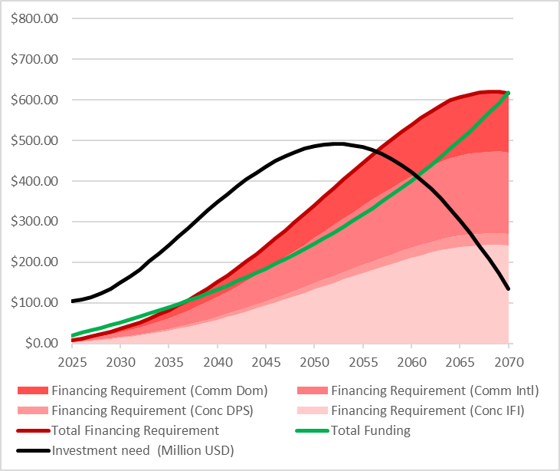
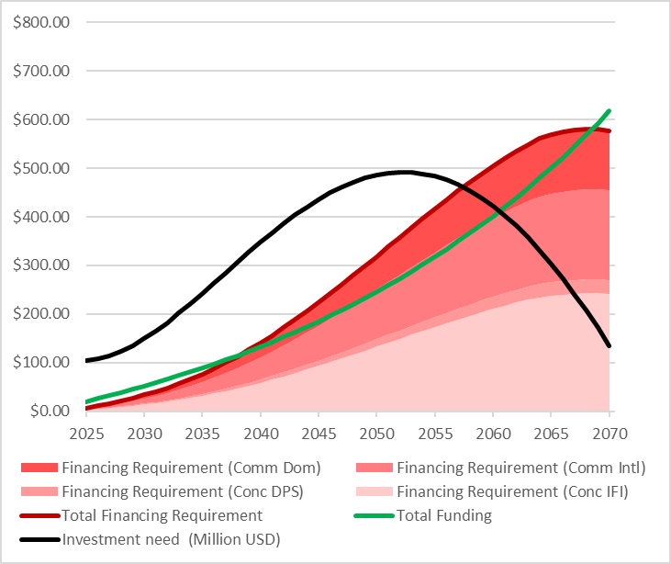
Reducing the WACC for commercial finance
THE DIFFERENCE NEEDS TO BE MORE DRAMATIC
Reducing the WACC for commercial finance decreases the financing requirement, thereby lowering the red line.
 | Conc IFI | Conc DPS | Comm Intl | Comm Dom
Share | 45% | 5% | 30% | 20%
WACC | 2.20% | 2.40% | 3.50% | 4.10%
 | Conc IFI | Conc DPS | Comm Intl | Comm Dom
Share | 45% | 5% | 30% | 20%
WACC | 2.20% | 2.40% | 3.00% | 3.00%
Notes:
To implement this measure in the MINFin dashboard, the user will need to modify the WACC associated with international commercial finance to reflect the anticipated reduction in the country risk premium. The model will feed this through into the calculation of the Financing Requirement (FR) for that portion of the investment plan that is expected to be financed by international commercial sources, thereby reducing the associated repayments and moving the red line downwards as shown in the figure.
To avoid unrealistic assumptions, any scenario of this nature should be informed by an understanding of the following contextual factors:
A history of how the country risk premium has evolved over time in the country in question.
Benchmarks of country risk premiums from relevant comparator countries.
Reports from risk rating agencies discussing the expected evolution of the country’s risk premium.

Slide 10
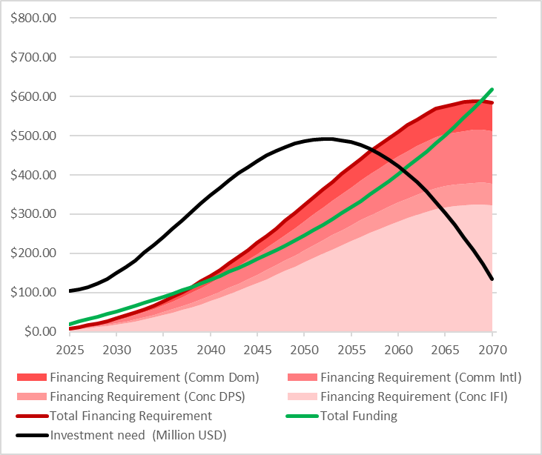
Increasing the share of concessional finance
THE DIFFERENCE NEEDS TO BE MORE DRAMATIC
Increasing the share of concessional finance reduces the overall WACC, thereby lowering the red line.
 | Conc IFI | Conc DPS | Comm Intl | Comm Dom
Share | 45% | 5% | 30% | 20%
WACC | 2.20% | 2.40% | 3.50% | 4.10%
 | Conc IFI | Conc DPS | Comm Intl | Comm Dom
Share | 60% | 10% | 20% | 10%
WACC | 2.20% | 2.40% | 3.50% | 4.10%
Notes:
To implement this measure in the MINFin dashboard, the user will need to modify the percentage of financing coming from international concessional sources to reflect the anticipated future capture of such resources. The model will feed this through into the calculation of the Financing Requirement (FR) by allocating a higher portion of the investment to international concessional sources, thereby reducing the associated repayments and moving the red line downwards as shown in the figure.
To avoid unrealistic assumptions, any scenario of this nature should be informed by an understanding of the following contextual factors:
A history of how much concessional finance the country has captured in recent year (recall Lecture 4 on the Financing Baseline).
A survey of potential untapped sources of concessional finance that may be available (recall Lecture 5 on FinTrack)
Benchmarks on capture of international concessional finance from relevant comparator countries.

Slide 11

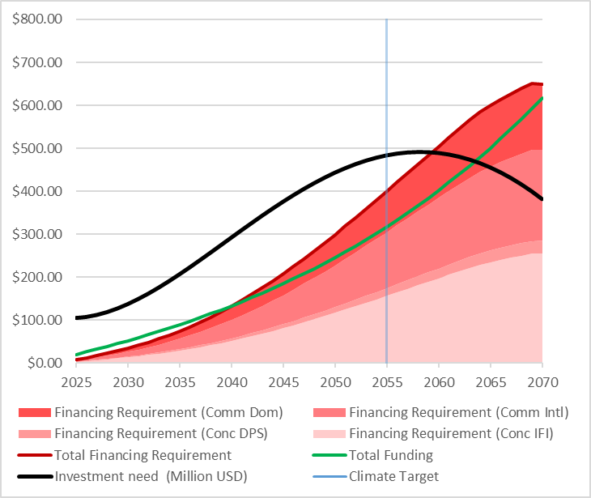
Setting less ambitious transition targets
THE DIFFERENCE NEEDS TO BE MORE DRAMATIC
Setting less ambitious climate targets delays the increase in financing requirements, thus lowering the red line.
 | Conc IFI | Conc DPS | Comm Intl | Comm Dom
Share | 45% | 5% | 30% | 20%
WACC | 2.20% | 2.40% | 3.50% | 4.10%
 | Conc IFI | Conc DPS | Comm Intl | Comm Dom
Share | 45% | 5% | 30% | 20%
WACC | 2.20% | 2.40% | 3.50% | 4.10%
Climate Target (2050)
Climate Target (2055)
Notes:
To implement this measure in the MINFin dashboard, the user will need to modify the OSeMOSYS investment plan selected for the financial modelling from the Net Zero (NZ) Investment Plan to the Least Cost (LC) Investment Plan or some Alternative Investment Plan (Alt) that is less ambitious in carbon terms.
The Net Zero (NZ) Investment Plan is the one that constrains the selection of energy technologies to meet forecast demand to those that are able to ensure Net Zero energy sector emissions by the target date.
The Least Cost (LC) Investment Plan is the one that selects the lowest cost energy technologies to meet forecast demand without applying any constraint on carbon emissions.
The Alternative Investment Plan (Alt) is one that applies some constraint on carbon emissions that is less ambitious than the original Net Zero Investment Plan. For example, if the Net Zero (NZ) Investment Plan aims for Net Zero emissions by 2050, an Alternative Plan might aim for Net Zero emissions by 2060 (or later) instead.
The use of a less ambitious investment plan will result in a reduced financing need leading to a smaller Financing Requirement (FR) for a given WACC. This is illustrated by a flatter profile for the Investment Needs (IN) (black line) in the figure, which feeds through into a flatter profile for the Financing Requirement (FR) (red line in the figure).
To avoid unrealistic assumptions, any scenario of this nature should be informed by an understanding of the following contextual factors:
A review of the country’s NDC commitments to climate transition made under the UNFCCC process.
A review of existing energy investment plans to understand their degree of alignment with Net Zero goals.

Slide 12
Boosting funding availability
Part 3

Slide 13
Ways to increase the Funding Availability
There are several ways to increase the Funding Availability
Raise government expenditure
Increase energy tariffs
Restructure utility financially
Redistribute investment obligations
Monetize carbon credits
Notes:
There are several ways to increase the Funding Availability, and these may be considered individually or in combination:
Raise government expenditure: Increasing energy sector allocations from the government budget is one obvious way of increasing the availability of funding. However, given competing claims on government expenditures, and the potential for energy to be a self-sustaining sector through user tariffs, the scope for allocating additional budget resources may be quite limited and/or confined to certain types of investments (e.g. rural electrification).
Increase energy tariffs: In many countries, retail energy tariffs are explicitly or implicitly subsidized and do not allow for full cost recovery. Even when tariffs allow for recovery of existing costs, they may not incorporate the future cost implications of the adoption of a Net Zero investment plan. It may therefore be relevant to consider raising energy tariffs for end-users as a means of boosting utility cashflows. This is likely to be politically sensitive and should never be undertaken lightly but always supported by adequate analysis of cost-of-service.
Restructure utility financially: In some countries, utilities present very weak financial performance and may even be close to bankruptcy. In such extreme situations, it may be that no amount of realistic tariff increases can generate an adequate cashflow to cover financing requirements. In such cases, a full financial restructuring may be required to restore utility cashflows. This may entail a combination of loan refinancing and capital injections to improve the utility’s balance sheet.
Redistribute investment obligations: In countries where there are multiple utilities, some of them may be in a much stronger financial position than others. In such cases, the allocation of investment obligations across utilities may affect the overall affordability of the investment plan. In particular, transferring investment obligations towards financially better performing utilities may help to take better advantage of funding availability.
Monetize carbon credits: A Net Zero investment plan will typically generate significant savings in carbon emissions relative to a Least Cost investment plan. Under some circumstances, it may be possible to monetize these savings by selling carbon credits.
Finally, the opposite logic also holds. If any of these elements move in the opposite direction – lower government expenditure, reduced energy tariffs, misallocated investment obligations, reduced value of carbon credits – the financing gap is likely to increase.

Slide 14
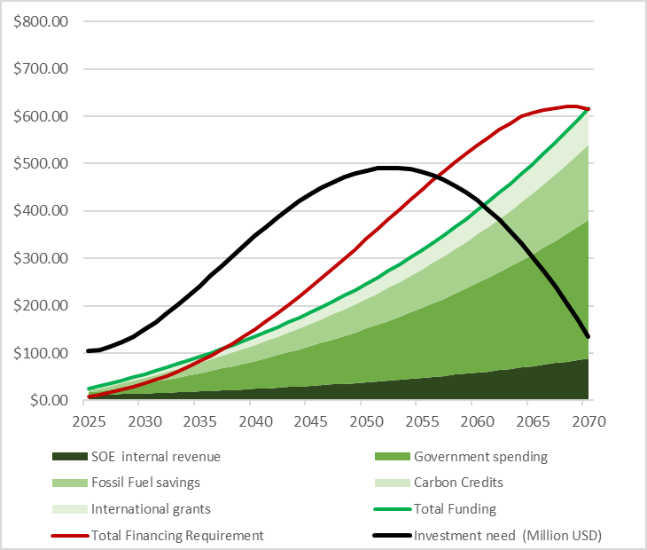
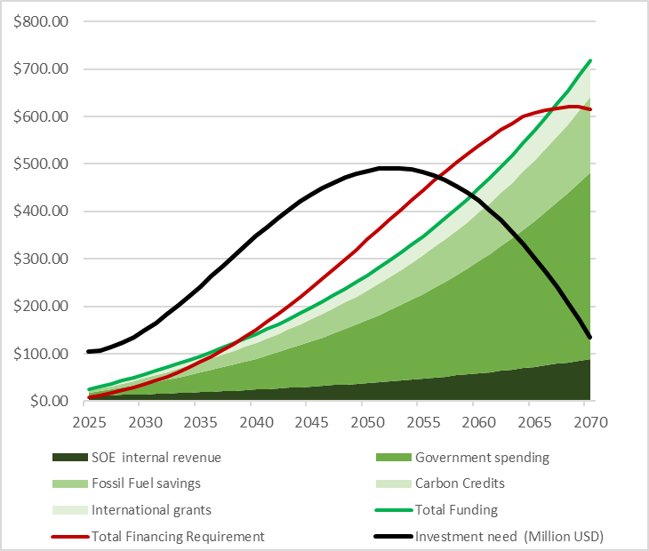
Raise government expenditure
WE NEED A FICTIONAL ILLUSTRATION OF THIS, INCORPORATING THE DASHBOARD WHERE THE ENERGY TARIFF IS CHANGED AND SHOWING THE MOVEMENT IN THE GREEN LINE
…
 | International Grants | Government Budget | SOE Revenue
CAGR | 3.20% | 3.40% | 3.80%
Price elasticity |  |  | 0.53
Real energy price |  |  | 0.01
SOE Cash Injection |  |  | $0.00
 | International Grants | Government Budget | SOE Revenue
CAGR | 3.20% | 4.00% | 3.80%
Price elasticity |  |  | 0.53
Real energy price |  |  | 0.01
SOE Cash Injection |  |  | $0.00
Notes:
To implement this measure in the MINFin dashboard, the user will need to modify the CAGR associated with government expenditure to reflect a higher budget allocation to the energy transition. The model will feed this through into the calculation of the Funding Availability (FA), thereby shifting the green line upwards as shown in the figure.
To avoid unrealistic assumptions, any scenario of this nature should be informed by an understanding of the following contextual factors:
•A history of budget allocations to the energy sector in the country in question (recall Lecture 8 on the Funding Baseline).
•IMF reports that evaluate the budget composition and budgetary pressure in the country.

Slide 15
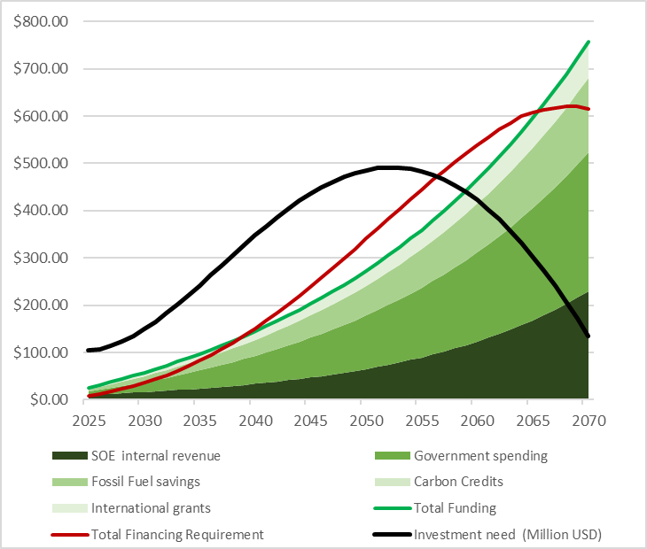
Boost utility cashflows by raising energy tariffs
WE NEED A FICTIONAL ILLUSTRATION OF THIS, INCORPORATING THE DASHBOARD WHERE THE ENERGY TARIFF IS CHANGED AND SHOWING THE MOVEMENT IN THE GREEN LINE
…
 | International Grants | Government Budget | SOE Revenue
CAGR | 3.20% | 3.40% | 3.80%
Price elasticity |  |  | 0.53
Real energy price |  |  | 0.01
SOE Cash Injection |  |  | $0.00
 | International Grants | Government Budget | SOE Revenue
CAGR | 3.20% | 3.40% | 6.25%
Price elasticity |  |  | 0.60
Real energy price |  |  | 0.03
SOE Cash Injection |  |  | $0.00
Notes:
To implement this measure in the MINFin dashboard, the user will need to modify the CAGR associated with the energy tariff to create stronger utility cashflows. At the same time, the user may want to consider modifying default assumptions regarding the income elasticity and price elasticity of demand for energy The model will feed this through into the calculation of the Funding Availability (FA), thereby shifting the green line upwards as shown in the figure.
The income elasticity of demand predicts how the demand for energy will respond to anticipated growth in national income.
The price elasticity of demand predicts how the demand for energy will respond to the requested change in the energy tariff.
To avoid unrealistic assumptions, any scenario of this nature should be informed by an understanding of the following contextual factors:
A history of energy tariff adjustments in the country.
Regulatory reports clarifying long term intentions regarding energy tariff adjustments and the existence of any multi-year tariff frameworks.

Slide 16
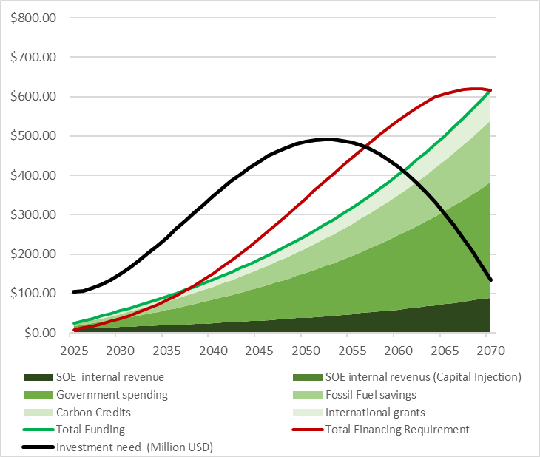
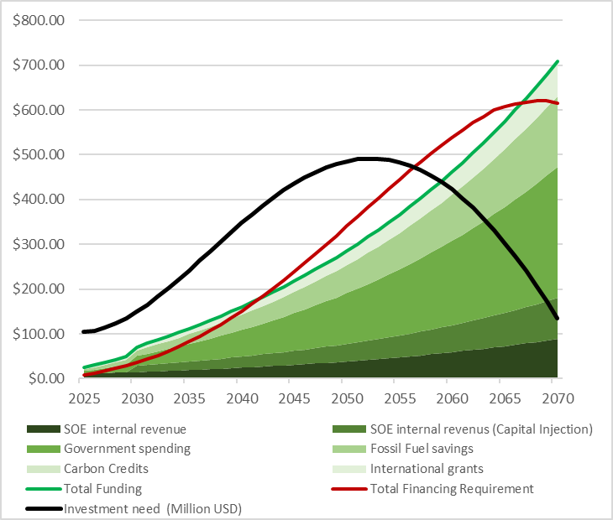
Restructure utility financially
WE NEED A FICTIONAL ILLUSTRATION OF THIS, INCORPORATING THE DASHBOARD WHERE A CAPITAL INJECTION IS MADE AND SHOWING THE MOVEMENT IN THE GREEN LINE
…
 | International Grants | Government Budget | SOE Revenue
CAGR | 3.20% | 3.40% | 3.80%
Price elasticity |  |  | 0.53
Real energy price |  |  | 0.01
SOE Cash Injection (2030) |  |  | $0.00
 | International Grants | Government Budget | SOE Revenue
CAGR | 3.20% | 3.40% | 3.80%
Price elasticity |  |  | 0.53
Real energy price |  |  | 0.01
SOE Cash Injection (2030) |  |  | $15.00
2030 SOE Capital Injection
Notes:
To implement this measure in the MINFin dashboard, the user may need to make multiple modifications that will feed through into the calculation of the Funding Availability (FA), thereby shifting the green line upwards as shown in the figure.
Capital injection. If the restructuring calls for an injection of equity capital, then this will need to be added into the SOE cashflow (recall Lecture 8)
To avoid unrealistic assumptions, any scenario of this nature should ideally draw upon an agreed utility financial restructuring plan based on a detailed financial model of the utility.

Slide 17
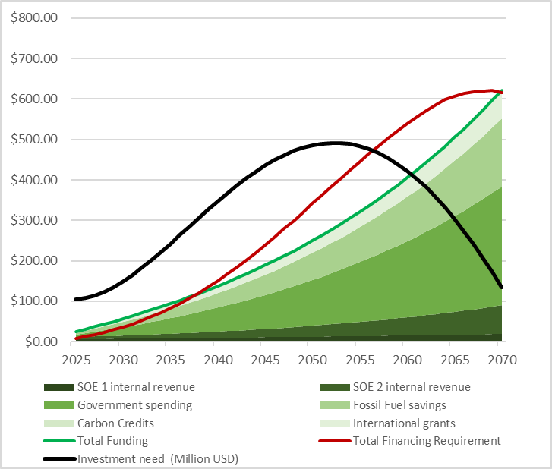
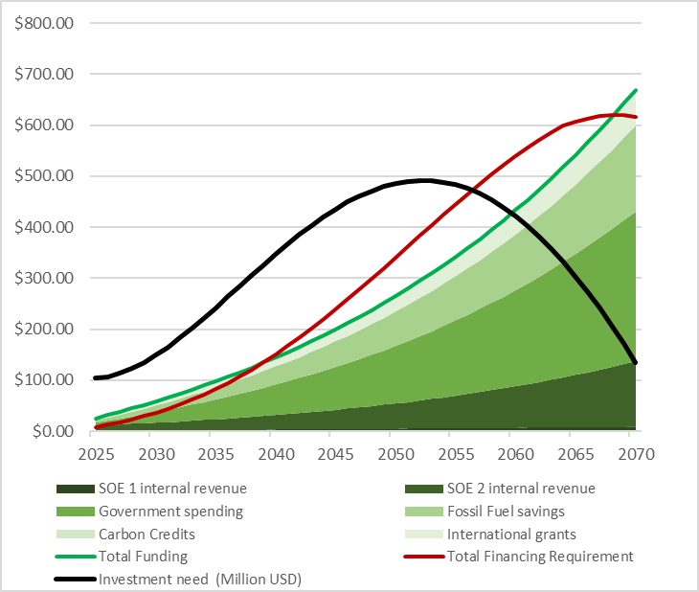
Redistribute investment obligations
WE NEED A FICTIONAL ILLUSTRATION OF THIS, INCORPORATING THE DASHBOARD WHERE THE CAGR FOR GOVERNMENT EXPENDITURE IS CHANGED AND SHOWING THE MOVEMENT IN THE GREEN LINE
…
 | International Grants | Government Budget | SOE 1 Revenue | SOE 2 Revenue
CAGR | 3.20% | 3.40% | 1.58% | 4.19%
Price elasticity |  |  | 0.11 | 0.6
Real energy price |  |  | 0.01 | 0.01
Share |  |  | 54.55% | 45.45%
 | International Grants | Government Budget | SOE 1 Revenue | SOE 2 Revenue
CAGR | 3.20% | 3.40% | 1.58% | 4.19%
Price elasticity |  |  | 0.11 | 0.6
Real energy price |  |  | 0.01 | 0.01
Share |  |  | 10% | 90%
Notes:
The implementation of this measure is not straightforward, because it calls for the disaggregation of the MINFin dashboard for different utilities, which can only be done on a country-specific customized basis. To make this possible the Financing Requirements (FR) and Funding Availability (FA) at the national level need to be fully disaggregated and allocated across the relevant utilities. Doing so, may reveal that a financing gap in one (or more) utilities coexists with a funding surplus in one (or more) utilities. Where this is the case, reallocating Financing Requirement (FR) from the utility in deficit to the utility in surplus can result in a better outcome.
This topic is too advanced for detailed treatment in this course. However, it is discussed here briefly to indicate that such refinements can be accommodated within this modelling framework.

Slide 18

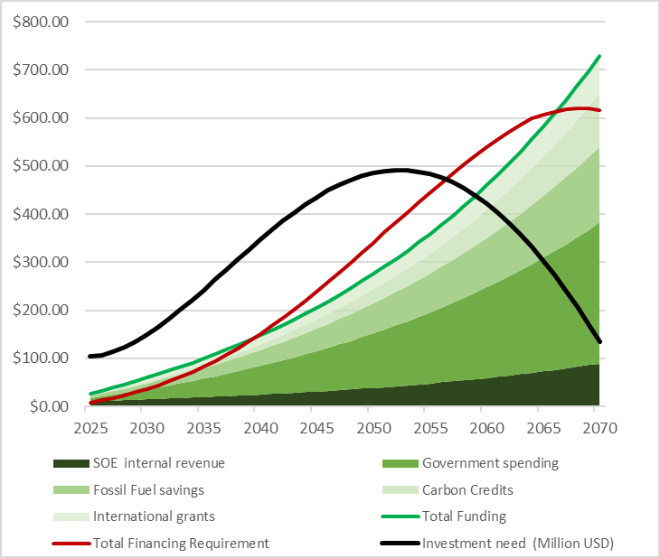
Restructure utility financially
WE NEED A FICTIONAL ILLUSTRATION OF THIS, INCORPORATING THE DASHBOARD WHERE A POSITIVE VALUE IS APPLIED TO CARBON CREDITS AND SHOWING THE MOVEMENT IN THE GREEN LINE
…
 | Carbon Credits | International Grants | Government Budget | SOE Revenue
CAGR | OFF | 3.20% | 3.40% | 3.80%
Price elasticity |  |  |  | 0.53
Real energy price |  |  |  | 0.01
SOE Cash Injection (2030) |  |  |  | $0.00
 | Carbon Credits | International Grants | Government Budget | SOE Revenue
CAGR | ON | 3.20% | 3.40% | 3.80%
Price elasticity |  |  |  | 0.53
Real energy price |  |  |  | 0.01
SOE Cash Injection (2030) |  |  |  | $0.00
Notes:
To implement this measure in the MINFin dashboard, the user will need to enter a positive value for carbon credits, which will be multiplied by the volume of carbon savings each year estimated by the OSeMOSYS model. The model will feed this through into the calculation of the Funding Availability (FA), thereby shifting the green line upwards as shown in the figure.
To avoid unrealistic assumptions, any scenario of this nature should be informed by an understanding of the following contextual factors:
Current and projected future prices of carbon credits on global markets.
Information on any carbon credit transactions that have taken place nationally.

Slide 19
Choosing and
Combining Approaches
Part 4

Slide 20
Combining approaches to closing financing gaps
It is quite likely that no single measure will be adequate to close a country’s financing gap, necessitating a combination of measures to be taken.
When exploring potential measures to close financing gaps, it is important to ensure that scenarios are informed by realism.
Measures for closing financing gaps differ markedly in terms of their characteristics, and their applicability to individual countries.
Notes:
It is quite likely that no single measure will be adequate to close a country’s financing gap, necessitating a combination of measures to be taken.
When exploring potential measures to close financing gaps, it is important to ensure that scenarios are informed by realism.
Measures for closing financing gaps differ markedly in terms of their characteristics, and their applicability to individual countries.

Slide 21
Choosing between measures to close financing gaps
 | Burden sharing | Speed of implementation | Ease of implementation
Reduce Financing Requirement
A. Reduce WACC for commercial finance | Efficiency gain | Slower | Lower
B. Increase share of concessional finance | International community | Faster | Higher
C. Adopt a lower cost investment plan | International community | Slower | Higher
Increase Funding Availability
A. Raise government expenditure | National population | Faster | Lower
B. Increase energy tariffs | National population | Faster | Lower
C. Restructure utility financially | Unclear | Slower | Higher
D. Redistribute investment obligations | Efficiency gain | Slower | Higher
E. Monetize carbon credits | International community | Faster | Higher
Notes:
The different measures identified for closing the financing gap can be compared along several dimensions.
Burden sharing: In some cases, the associated burden falls primarily on the international community, while on others the burden falls primarily on the national population, making the choice between measures a matter of just transition. The burden falls primarily on the international community, when more concessional finance is provided, or carbon credits are purchased, or a reduced investment plan delays the achievement of Net Zero targets imposing more climate change on the global community. The burden falls primarily on the national population, when energy tariffs are increased or government expenditure raised. In other cases, the measure leads to an efficiency gain that does not impose a burden on either side, such as when country risk is reduced or when investment obligations are more efficiently allocated across utilities.
Speed of implementation: Measures may differ significantly in terms of the speed of implementation, with speed likely to be context dependent. In general terms, it may prove quicker to take measures such as seeking more concessional finance, raising government expenditure, increasing energy tariffs, or monetizing carbon credits. It may prove slower to reduce country risk, adapt an investment plan, perform a financial restructuring exercise on a utility or redistribute investment obligations across utilities.
Ease of implementation: Measures may also differ significantly in terms of the ease of implementation, although again the relative ease will be context dependent. In general terms, it may prove more difficult to reduce country risk or make politically sensitive reforms such as tariff increases or budget reallocations. By comparison, it may prove easier to increase the share of concessional finance, adopt a different investment plan, restructure a utility financially, redistribute investment obligations or monetize carbon credits.
In creating a realistic package of measures that could be applied in any particular country context, it will be important to evaluate the feasibility of each of these measures and to estimate the potential scope for their application. For example, energy tariffs and/or budget envelopes could potentially be increased by 10 percent an no more. Or, carbon credits could be monetized for no more than US$30 per tonne. Or, US$200 million is the maximum amount of additional concessional finance that could be secured. Establishing such indicative ceilings, helps to ensure that scenarios are realistic.

Slide 22
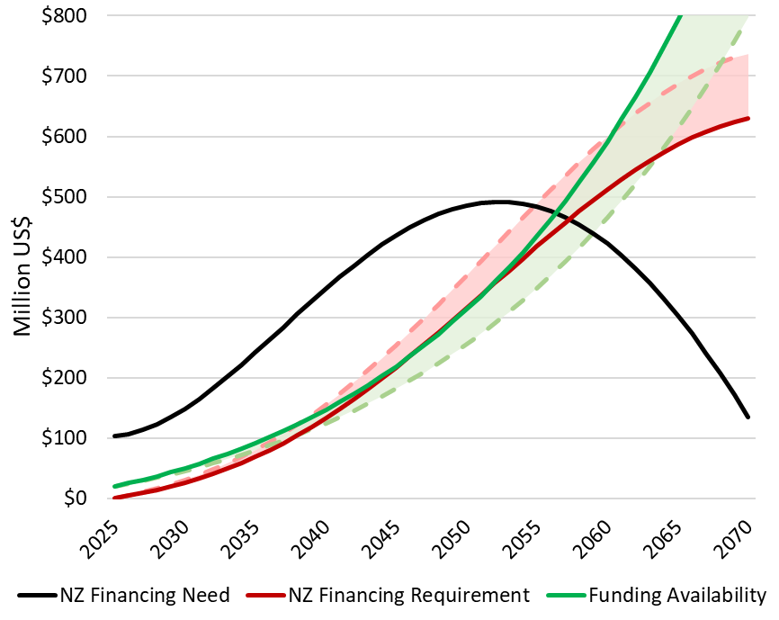
Closing the gap
All things considered, there are two possible alternative outcomes
EITHER, it is possible to close the financing gap with a combination of realistic measures
OR, a financing gap remains after all realistic measures have been adopted
Notes:
While it is usually possible to find a combination of measures that can close the Financing Gap (FG), this is not necessarily helpful unless such measures are realistic. In that sense, it is important to limit measures taken to those that are compatible with the country context, and comparable in scale to what has proved feasible in other similar countries. Considerations of realism mean that there may be countries that retain a Financing Gap (FG), even after all realistic measures have been taken.

Slide 23
Running the analysis in reverse
The same analysis can be run in two directions:
BACKWARDS, as a means of identifying measures that could potentially close an existing financing gap (as has been done here), with the aim of working backwards from a desired zero gap to the measures needed to achieve such a zero gap
FORWARDS, as a means of simulating how an existing financing gap is likely to evolve in future under different scenarios of anticipated change, that could potentially lead to either an improvement or deterioration in the financing gap
Notes:
This whole lecture has taken the perspective of a country that starts with a Financing Gap (FG) that needs to be closed. The discussion has focused on identifying all possible measures to eliminate the Financing Gap (FG), working backwards from this goal.
However, the same framework can also be used in a forward-looking direction, even for a country that has no Financing Gap (FG) at present, but which wishes to understand how the Financing Gap (FG) might evolve over time as a result of changes in the different factors identified in this lecture, such as energy tariffs, public expenditure, carbon credit prices, country risk premia, availability of concessional finance, etcetera. In this case, one would take the same approach but simply develop scenarios of how these variables are likely to evolve in the future and use MINFin to simulate the anticipated impact on the Financing Gap (FG).

Slide 24
Thank you
Contact Information: v.foster@imperial.ac.uk or hannah.luscombe@ouce.ox.ac.uk

